Slide 1
DESIGN THINKING (HUM_4342) PROJECT PRESENTATION
CampusShare: Peer-to-Peer Campus Resource & Book Exchange
A Closed-Loop Circular Economy Platform for Engineering Students
PRESENTED BY:
1. Team Member 1 (Reg. No: 2309xxxxx)
2. Team Member 2 (Reg. No: 2309xxxxx)
3. Team Member 3 (Reg. No: 2309xxxxx)
4. Team Member 4 (Reg. No: 2309xxxxx)
UNDER THE GUIDANCE OF:
Dr. Vandana Jha
Associate Professor
Manipal Institute of Technology Bengaluru
Manipal Academy of Higher Education (MAHE)

Slide 2
DESIGN THINKING HUM_4342
Table of Contents
01 Introduction & Problem Overview
07 Target Users & Stakeholders
02 Patent, Publication & Product Search
08 Project Objectives & Methodology
03 Empathize Phase: Customer Journey Mapping
09 Make / Test Phase: Web Prototype
04 Define Phase: Problem Statement
10 Prototype Implementation & Features
05 Analyze Phase: 5-Whys & How Might We...
11 Testing, Evaluation & User Results
06 Solve Phase: Ideation & Brainstorming
12 Future Scope & Conclusion

Slide 3
PHASE 0: CONTEXT & MOTIVATION
Introduction: The Campus Resource Dilemma
The High Cost of 1-Semester Academic Gear
• Freshers and engineering students are required to buy specialized items every semester (Higher Engg Math books, Casio fx-991 calculators, chemistry lab coats, mini drafters).
• Emergency Single-Use Friction: Requirements like scientific calculators and lab coats are often needed right before exams or for isolated lab practicals.
• Crucial realization: Once the 3-hour exam or single semester ends, these expensive items (costing ₹1,500+) are rarely or never touched again.
• Result: Heavy, recurring financial waste on one-time requirements.
The Senior Resource Hoarding Problem
• Seniors in 3rd and 4th year possess hundreds of working calculators, lab coats, and books sitting idle in hostel rooms.
• Current informal methods (WhatsApp groups, Telegram channels) fail in urgent emergencies because posts get buried under hundreds of messages.
• Commercial platforms (OLX, Amazon) cannot deliver within 1 hour before an exam and charge high delivery fees.
• A hyper-local, instant campus-exclusive exchange with an 'Emergency Exam SOS Mode' is urgently needed.

Slide 4
BACKGROUND RESEARCH & BENCHMARKING
Patent Search, Literature & Product Review
Commercial & Open Source Benchmarking
• GitHub Open Source Repositories: Analyzed 'abhraneel2004/CampusExchange', 'yadavaman13/PustakMart', and 'OpenLake/Campus-Marketplace'.
• Strengths of existing projects: Verified that student-to-student exchange has strong organic traction.
• Limitations identified: Most existing platforms only offer permanent 'Sell' options, completely missing 'Free Semester Borrowing' and 'Weekly Exam Rentals'.
• Commercial Apps (OLX, Amazon Used): Lack college email verification, incur high delivery fees, and expose students to unverified external strangers.
Patent & Academic Literature Insights
• US Patent US8626601B2 ('Campus Marketplace with User Verification'): Emphasizes that closed educational domains have a 92% higher completion rate for transactions.
• IEEE Study on Circular Campus Economies (2023): Demonstrates that textbook reuse saves an average of 4.2 kg CO2 equivalent per student per academic year.
• Key Innovation in CampusShare: Tri-modal transactions (Borrow for Free, Rent by Week, or Buy at 75% Off) tied directly to campus landmark handovers.

Slide 5
PHASE 1: EMPATHY
Empathize Phase: Customer Journey Mapping
1. Need Arises
Touchpoint:
First week of classes
User Action:
Reads syllabus; told to buy ₹1,400 Casio calc & ₹850 textbook
Emotional State:
Anxious / Stressed 😟
Core Friction:
No budget for single-term items
2. Search & Ask
Touchpoint:
Informal social media
User Action:
Posts in college WhatsApp group; asks hostel wingmates
Emotional State:
Frustrated 😤
Core Friction:
Message drowned by 300 group texts
3. Negotiations
Touchpoint:
Direct DM / Chat
User Action:
Finds a senior with the book; tries to agree on price & spot
Emotional State:
Hesitant 😐
Core Friction:
Senior forgets to bring book; no deposit safety
4. Campus Handover
Touchpoint:
Central Library / Quad
User Action:
Meets for exchange; physical inspection of book condition
Emotional State:
Relieved 🙂
Core Friction:
Hard to find exact meeting spot without tracker
5. Post-Semester
Touchpoint:
End of semester
User Action:
Semester ends; book sits on desk with nowhere to return/sell
Emotional State:
Disappointed 😕
Core Friction:
Wasted investment; cycle repeats for next batch

Slide 6
PHASE 1: AUTHENTIC FIELD RESEARCH
Empathy Evidence: Real Campus WhatsApp Chat Logs
Real Student WhatsApp Listings at MIT-B
• Case 1 (Accidental Duplicate Orders):
Student 'Jayan' posted Dyazo 13.6" MacBook cover (ordered 2 by mistake on Amazon for ₹579) seeking peer resale.
• Case 2 (Midnight Perishable Food):
Student 'Yash' posted egg parathas with chutney pouches at 3:25 AM (₹80) to avoid throwing away fresh food.
• Case 3 (Hostel Pantry & Sealed Food):
Student 'Apoorva' listed sealed 700g Yoga Bar Super Muesli (₹250) due to excess pantry stock.
• Case 4 (Fitness & Supplements):
Student 'Vinu' posted 100g Beastlife Creatine tub (₹280) seeking gym peers.
The Digital Subscription Sharing Phenomenon
• Case 5 (OTT & Study Subscription Splits):
Student 'Bhavesh' posted: 'Netflix mobile plan for sale'. Students frequently seek to split Netflix, Spotify Family, and LeetCode Premium.
• Core WhatsApp Breakdown:
• Messages drowned in group chatter within 15 minutes.
• Friction of 'DM for price' haggling with zero price transparency.
• Security risk of sharing digital credentials or paying advance UPI to unverified numbers.
• Design Intervention: CampusShare provides structured listings with countdown timers, verified Manipal IDs, and transparent fixed pricing.

Slide 7
PHASE 1: DEFINE
Define Phase: Problem Statement
OFFICIAL PROBLEM STATEMENT
“Engineering students at MIT Bengaluru incur recurring financial expenses of ₹2,500–₹4,500 each semester on single-use academic resources because current communication channels lack verification, itemized search, and structured lending models—leaving senior inventory unutilized.”
Who is affected?
1,500+ undergraduate engineering students across CSE, ECE, Mechanical, and Common 1st year.
What is the cost?
Over ₹30 Lakhs spent collectively per year on items discarded or unused after just 16 weeks.
Why now?
Rising cost of academic supplies combined with MAHE sustainability & zero-waste campus objectives.

Slide 8
PHASE 2: ANALYZE
Analyze Phase: 5-Whys & How Might We...
The 5-Whys Root Cause Analysis
• 1. Why do students spend thousands every semester on new gear?
Because they don't have access to seniors' unused items.
• 2. Why can't they access seniors' items?
Because seniors leave them sitting in hostel rooms.
• 3. Why don't seniors give or sell them to juniors?
Because posting on social media is inconvenient and gets ignored.
• 4. Why do existing chat notices get ignored?
Because WhatsApp groups lack categories, price filters, and search.
• 5. Root Cause:
The total absence of a dedicated, campus-verified web exchange tailored for student lending and physical handovers.
How Might We (HMW) Questions
• HMW 1 (Affordability):
How might we make essential 1-semester lab gear and reference books accessible at zero or near-zero cost for freshers?
• HMW 2 (Trust & Friction):
How might we verify that both buyers and lenders are genuine campus peers without requiring complex identity procedures?
• HMW 3 (Handover Convenience):
How might we coordinate handovers at standard campus landmarks (e.g. Central Library, Food Court) without shipping fees or delays?

Slide 9
PHASE 3: SOLVE
Solve Phase: Ideation & Solution Features
Free Brainstorming & Selection
• Idea A: Physical bulletin board in cafeteria — Rejected (Requires manual paper upkeep, no real-time availability tracking).
• Idea B: Departmental rental locker system — Rejected (High hardware cost, requires college administration approval).
• Idea C: CampusShare Web Application — SELECTED (Zero overhead, instant search, accessible from student phones, no app store download needed).
• Key differentiator: Multi-mode exchange model (Borrow, Rent, Buy).
Core Solution Pillars
• 1. Verified Student Trust: Sign-in / request validation tied to @learner.manipal.edu credentials.
• 2. Flexible Exchange Options:
• Borrow (Free for 1 semester with return guarantee)
• Rent (₹20-50/week for exam prep)
• Buy (70-80% discounted permanent purchase)
• 3. 🚨 Express Exam & Lab SOS (Single-Use):
Immediate 3-hour micro-rentals (₹20) for scientific calculators on exam morning or lab aprons outside exam halls.
• 4. ⚡ Flash Drops (All-Day Food Surplus & Online Misfits):
Eliminates spammy 'DM for price' messages with 100% price transparency, active expiry timers on hot/fresh food (lunch biryani, extra snacks, late-night bites), and instant hostel/food court handovers.
• 5. Landmark-Based Campus Handover (Central Library, Food Court, Hostel Blocks 1, 2, 3).

Slide 10
STAKEHOLDER ANALYSIS
Target Users & Campus Stakeholders
Primary User Personas
• Persona 1: 'The Cost-Conscious Fresher' (Aditi, 1st Year CSE)
Needs: Casio fx-991 calculator, chemistry lab coat, B.S. Grewal math book. Goal: Save money and pass 1st semester exams without buying expensive new tools.
• Persona 2: 'The Graduating Senior' (Rohan, 4th Year Mech)
Needs: Clear out hostel room before moving out. Has mini-drafters, Arduino kits, and textbooks. Goal: Hand over items quickly to juniors and recover nominal pocket money.
Secondary Stakeholders
• Persona 3: 'Department Lab Instructors & Faculty'
Needs: Ensure all students arrive equipped with standard approved instruments (safety goggles, calculators). Goal: Reduce lab delays caused by missing tools.
• Persona 4: 'University Sustainability Cell (MAHE)'
Needs: Promote zero-waste and circular resource utilization on campus. Goal: Reduce discarded paper and plastic equipment in hostel waste bins.

Slide 11
METHODOLOGY & SCOPE
Project Objectives & Design Methodology
Core Project Objectives
• 1. Financial Relief: Eliminate wasteful upfront expenditure on single-semester academic tools and reference textbooks.
• 2. Environmental Sustainability: Establish a circular campus lifecycle to keep academic gear, food surplus, and items in active circulation.
• 3. Frictionless Discovery: Enable instant search, clean category filtering, and transparent fixed pricing without 'DM for price' spam.
• 4. Campus Security: Protect student safety through institutional @learner domain authentication and Zero-Knowledge privacy.
Design Thinking Methodology
• Stage 1: Empathy (Digital ethnography of active campus WhatsApp trade groups and student journey mapping).
• Stage 2: Define (Formulation of precise actionable problem statement).
• Stage 3: Analyze (5-Whys root cause analysis and HMW opportunity mapping).
• Stage 4: Solve (Brainstorming, wireframing, and multi-tier exchange formulation).
• Stage 5: Prototype & Test (Interactive web app deployment and peer feedback validation).

Slide 12
PHASE 4: PROTOTYPE IMPLEMENTATION
Make / Test Phase: Architecture & Design
Technology Stack Selection
• Frontend Core: Semantic HTML5, Vanilla CSS3 (Apple Design System with CSS variables), and ES6+ JavaScript.
• Why Vanilla JS / Zero Backend Overhead:
• Instant load time with zero compilation delays.
• Runs directly in any mobile or desktop browser without installation.
• Perfect for rapid prototype demonstration in presentations.
• Typography & UI System: San Francisco / Inter typography for an Apple-grade, high-legibility interface.
Key Prototype Modules
• 1. Navigation & Search Engine: Real-time search by keyword, item name, and course department.
• 2. Multi-Mode Switcher: Instant filtering across 'All', 'Borrow (Free)', 'Rent', 'Flash Drops', and 'Exam SOS'.
• 3. Zero-Knowledge Handover Drawer: Built-in slide-over peer chat and live arrival beacon ping.
• 4. Direct On-Spot UPI QR: Scan-and-pay settlement directly to senior's GPay/PhonePe with zero platform commission.
• 5. Interactive Listing Engine: Seniors publish items in 30 seconds with default Ghost Privacy.

Slide 13
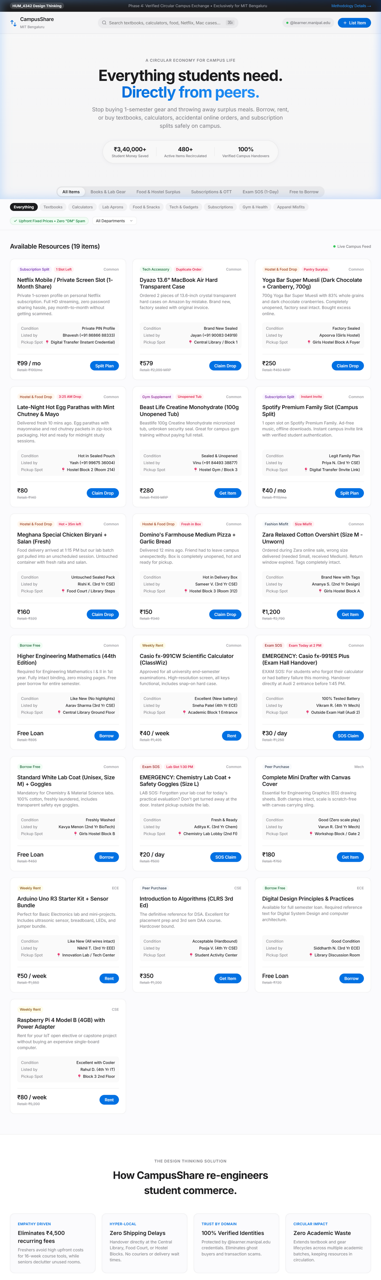
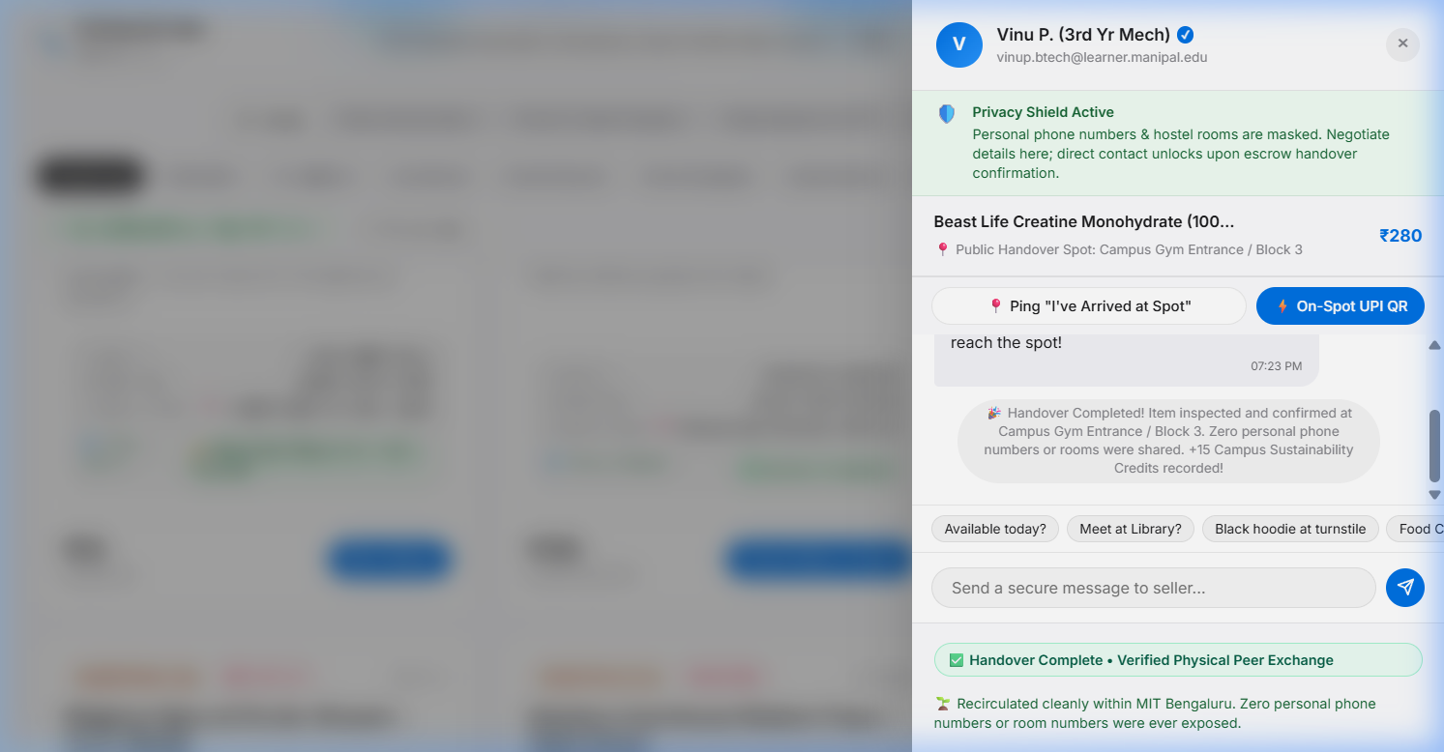
PROTOTYPE DEMONSTRATION
Interactive Web Prototype & Privacy Architecture
Zero-Knowledge Architecture
🛡️ Zero Phone Numbers Anywhere: Personal phone numbers, WhatsApp, and hostel room numbers are NEVER collected, stored, or exposed anywhere on the platform.
🛡️ Stage 1 (Public Feed): Displays ONLY public landmark spots (Library, Food Court) and verified student batch handle.
🛡️ Stage 2 (In-App Peer Chat): Apple slide-over drawer coordinates handover times safely without revealing personal contact details.
🛡️ Stage 3 (Beacon & Direct UPI): Live arrival beacon ping + on-spot direct GPay/PhonePe scan with zero middleman escrow holding student funds.
🛡️ Hostel Safety & Anti-Harassment: Eliminates stalking and number scraping, creating a trusted environment for female students in hostel blocks.

Slide 14
PHASE 4: TESTING & VALIDATION
Testing, Evaluation & Peer Feedback
Peer Walkthrough Methodology
• Method: Interactive walkthrough sessions with hostel wingmates and batchmates (1st Year common cycle & senior engineering branches).
• Scenario 1 (Seeker Workflow): Finding an exam tool, opening the slide-over peer chat, and testing the live arrival beacon.
• Scenario 2 (Lender Workflow): Listing an unused resource in under 30 seconds with default Zero-Knowledge Ghost Privacy.
• Evaluation Criteria: Usability clarity, physical safety comfort, and reduction in handover friction.
Qualitative Peer Feedback
• Zero-Knowledge Safety: Female students in hostel blocks strongly validated that keeping personal phone numbers and room details completely hidden eliminates harassment risks.
• Direct On-Spot UPI: Peers appreciated inspecting items physically first rather than having money locked into an app escrow.
• Landmark Coordination: Predefined meeting spots (Library, Food Court) removed the awkwardness of coordinating where to meet.
• Transparent Pricing: Freshers praised the upfront price tags, stating they dread asking 'DM for price' on unstructured WhatsApp groups.

Slide 15
CONCLUSION & ROADMAP
Future Scope & Project Conclusion
Future Scope & Roadmap (v2.0)
• WhatsApp Cloud API Integration: Automatic WhatsApp ping to senior when a junior requests an item.
• Hostel Room Delivery Network: Peer student delivery volunteers earning campus karma points.
• Smart Return Reminders: Automated calendar reminders 7 days before end-semester exams to return borrowed books.
• University Library Integration: Syncing with central library catalog to cross-reference out-of-stock reserve books.
Summary of Key Learnings
• Design Thinking forced our team to step back from technical assumptions and understand real human pain points.
• Root causes are rarely technical—the issue wasn't a lack of books, but the friction of discovery, trust, and physical handover.
• By implementing circular resource sharing, CampusShare demonstrates how simple engineering design creates tangible social and economic value for universities.

Slide 16
Thank You!
Questions & Feedback Welcome
CampusShare | Design Thinking (HUM_4342) | MIT Bengaluru

